Slide 1
AWS VPC PROJECT
Creating a network layer

Slide 2
Table of contents :
Overview
Projects outlines
AWS CLI
How to navigate through AWS documentation
Commands and demo
Outputs
Questions

Slide 3
Overview :
In our project we create a network layer , run an instance and test that our application is running all done using the AWS CLI. We must create all the corresponding features needed to run the application including security groups , route tables and subnets .

Slide 4
Outlines :
First, we gonna walkthrough how to install the AWS CLI and its benefits then we navigate through the AWS documentation to search for commands next we demonstrate our projects commands and then the ouptut results

Slide 5
AWS CLI:
Download the AWS CLI: Visit the official AWS CLI download page: https://docs.aws.amazon.com/cli/latest/userguide/getting-started-install.html

Slide 6
Benefits of using AWS CLI instead of :
Scripting and Batch Processing: Automate repetitive tasks, such as creating resources, configuring settings, or executing complex workflows.
Faster Operations: Perform tasks more efficiently compared to using the AWS Management Console.
Bulk Operations: Manage multiple resources simultaneously, saving time and effort.

Slide 7
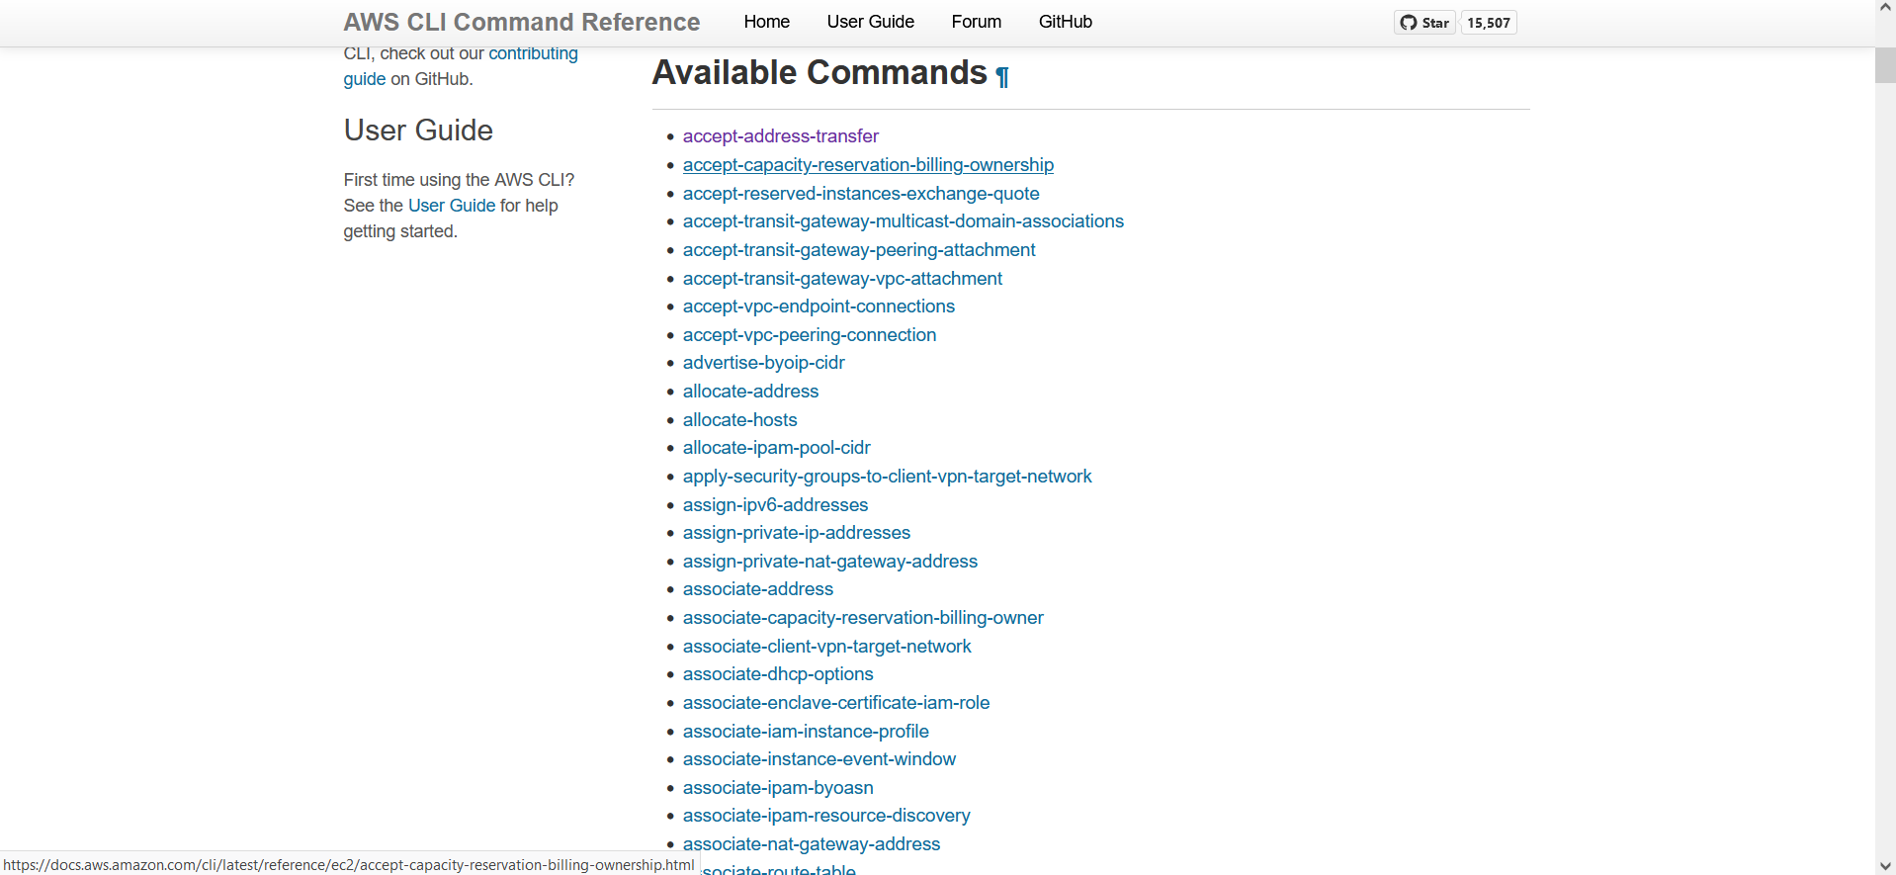
Navigating through AWS documentation
-First you need to browse to aws documentation for example this what appears in search for ec2 commands

Slide 8
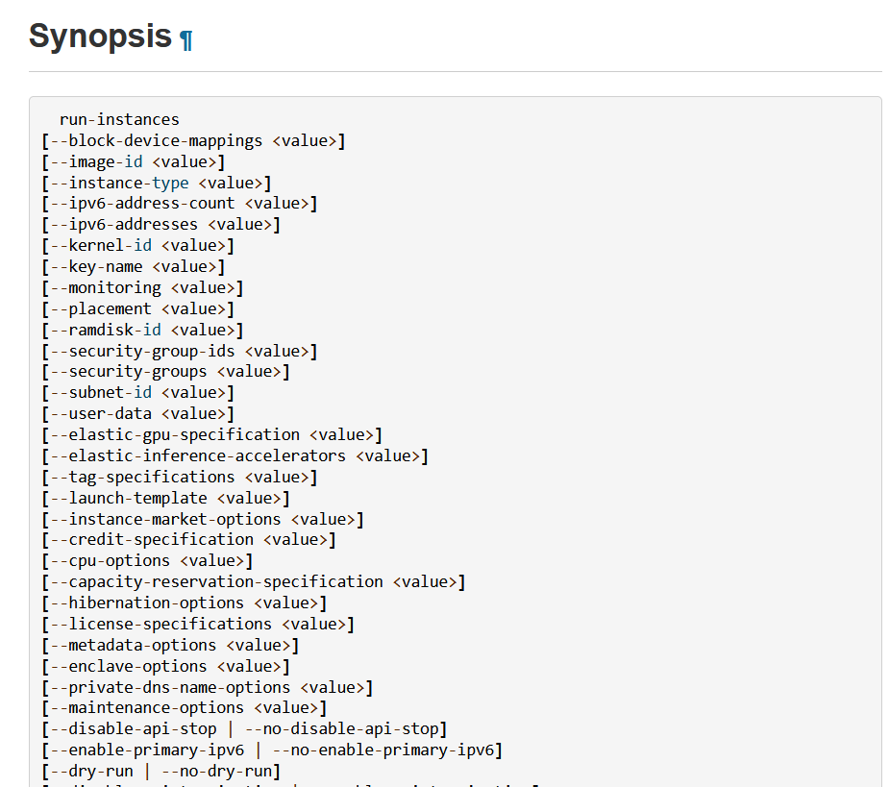
Navigating through AWS documentation
-second you need to browse to one of these commands and follow through on how to create resources and use the synopsis

Slide 9
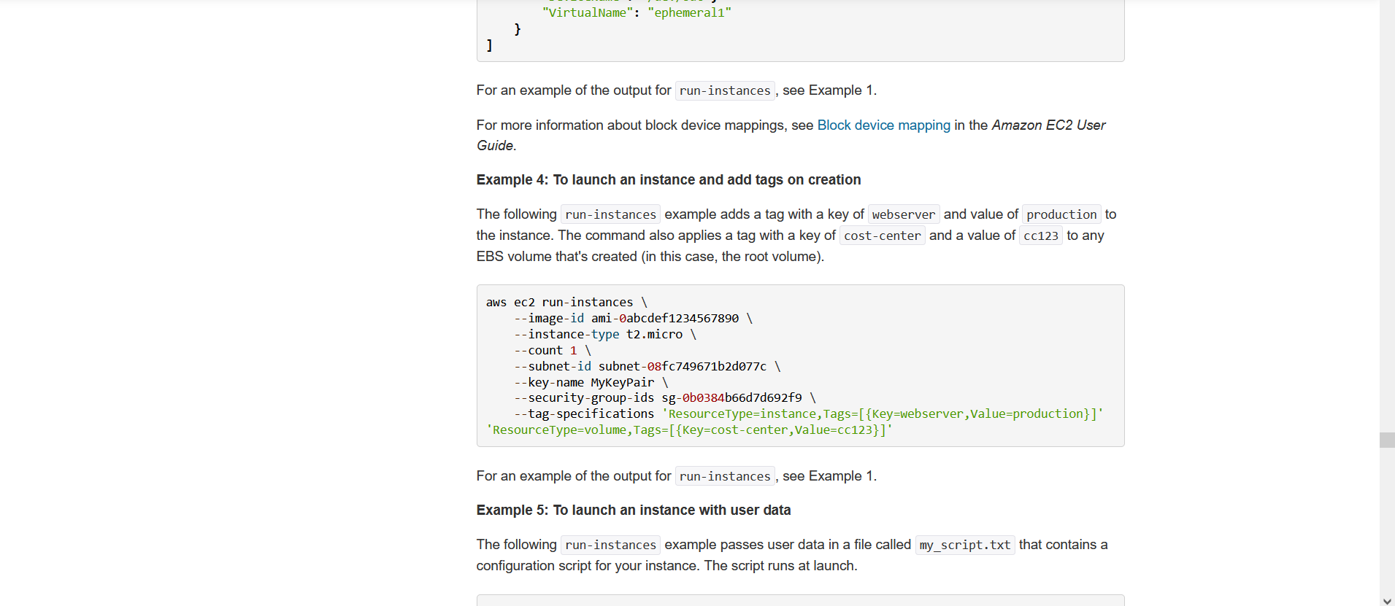
Navigating through AWS documentation
-here is an example of how to run instances from the command “run-instance”

Slide 10
How to create a network layer for our application
-First we create a vpc using the command

Slide 11
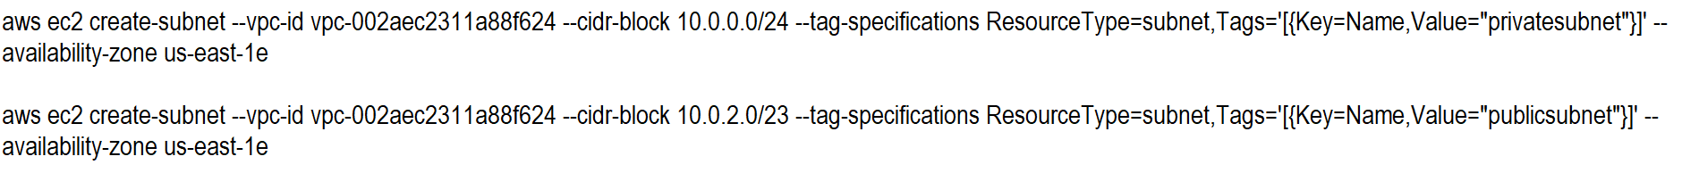
How to create a network layer for our application
-second we create a private and public subnet using the commands

Slide 12
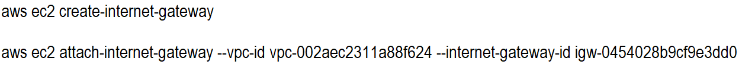
How to create a network layer for our application
-then we create an internet gateway

Slide 13
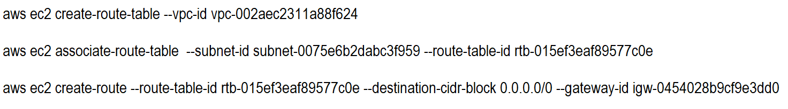
How to create a network layer for our application
-then we create a route table :

Slide 14
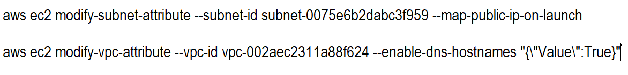
How to create a network layer for our application
-then we modify both VPC and subnet attributes :

Slide 15
How to create a network layer for our application
-then we create a security group

Slide 16
How to create a network layer for our application
-then we create our application instance :

Slide 17
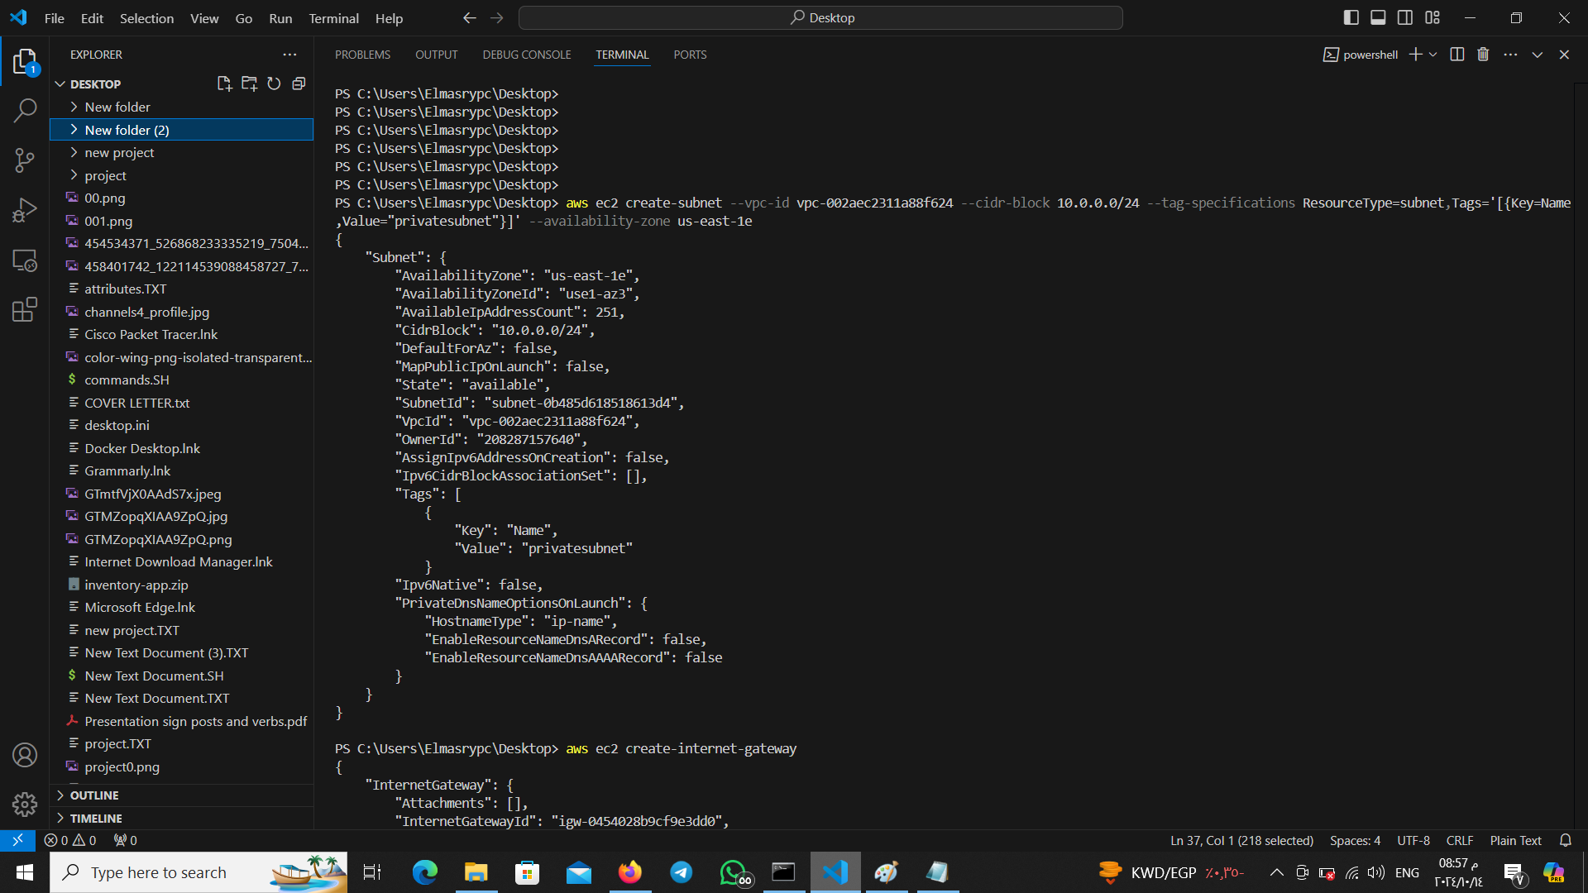
outputs

Slide 18
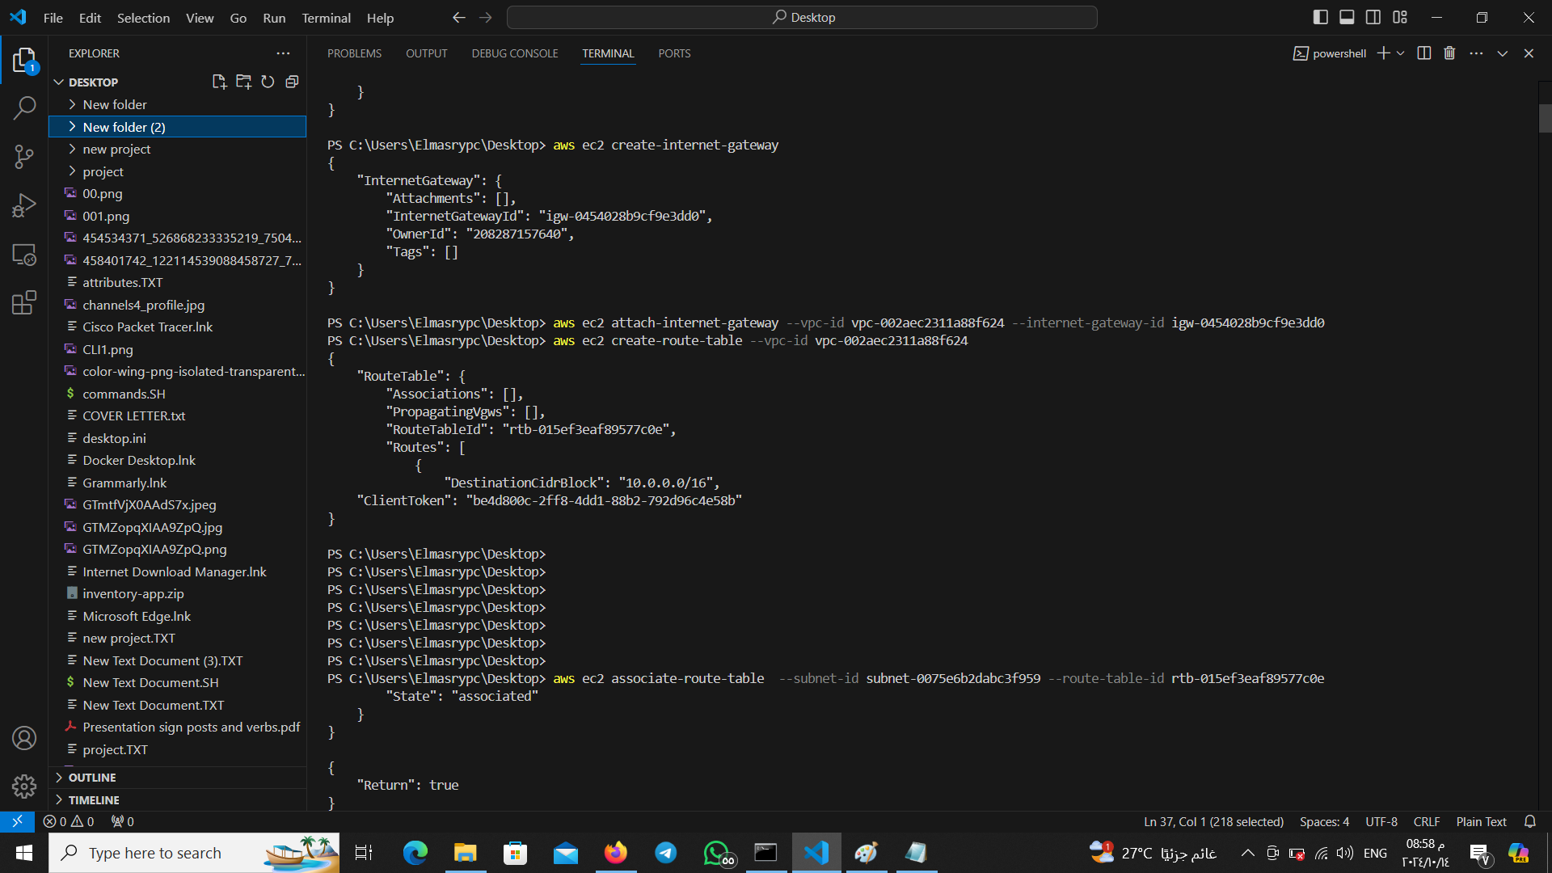
outputs

Slide 19
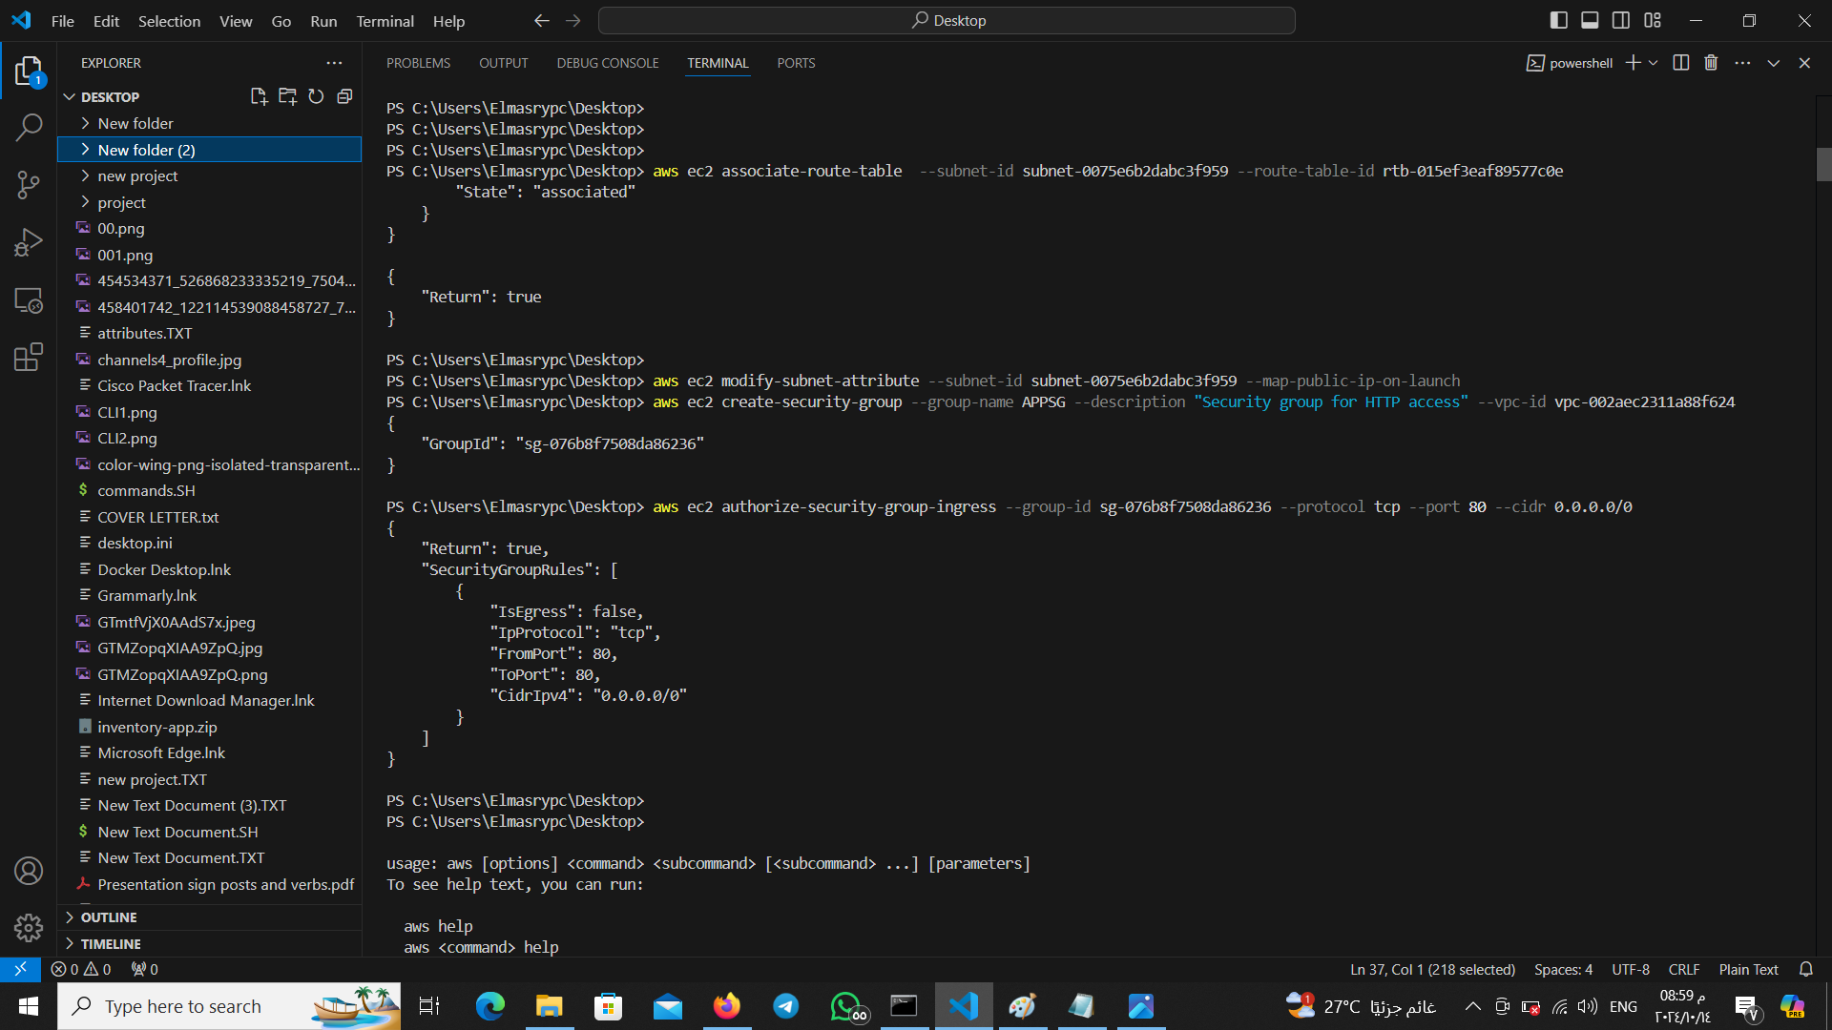
outputs

Slide 20
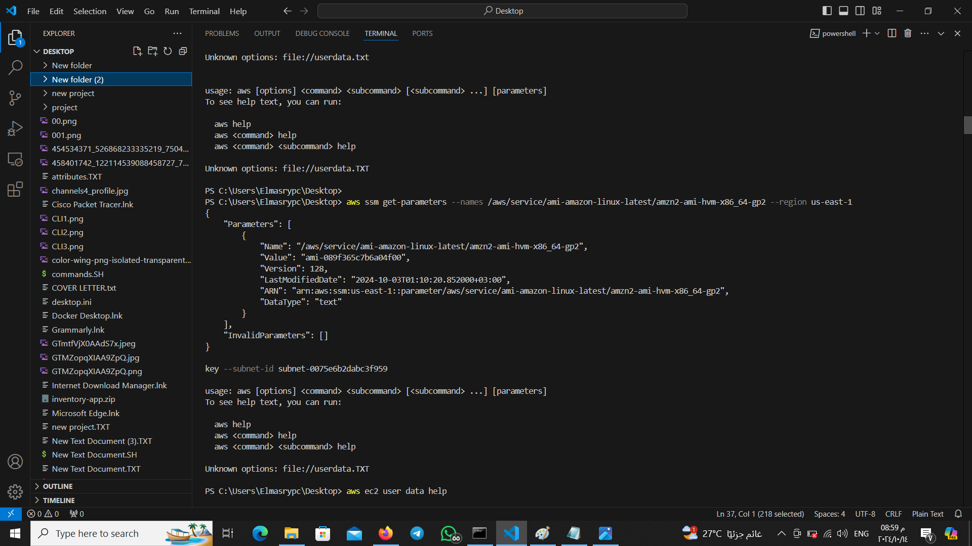
outputs

Slide 21
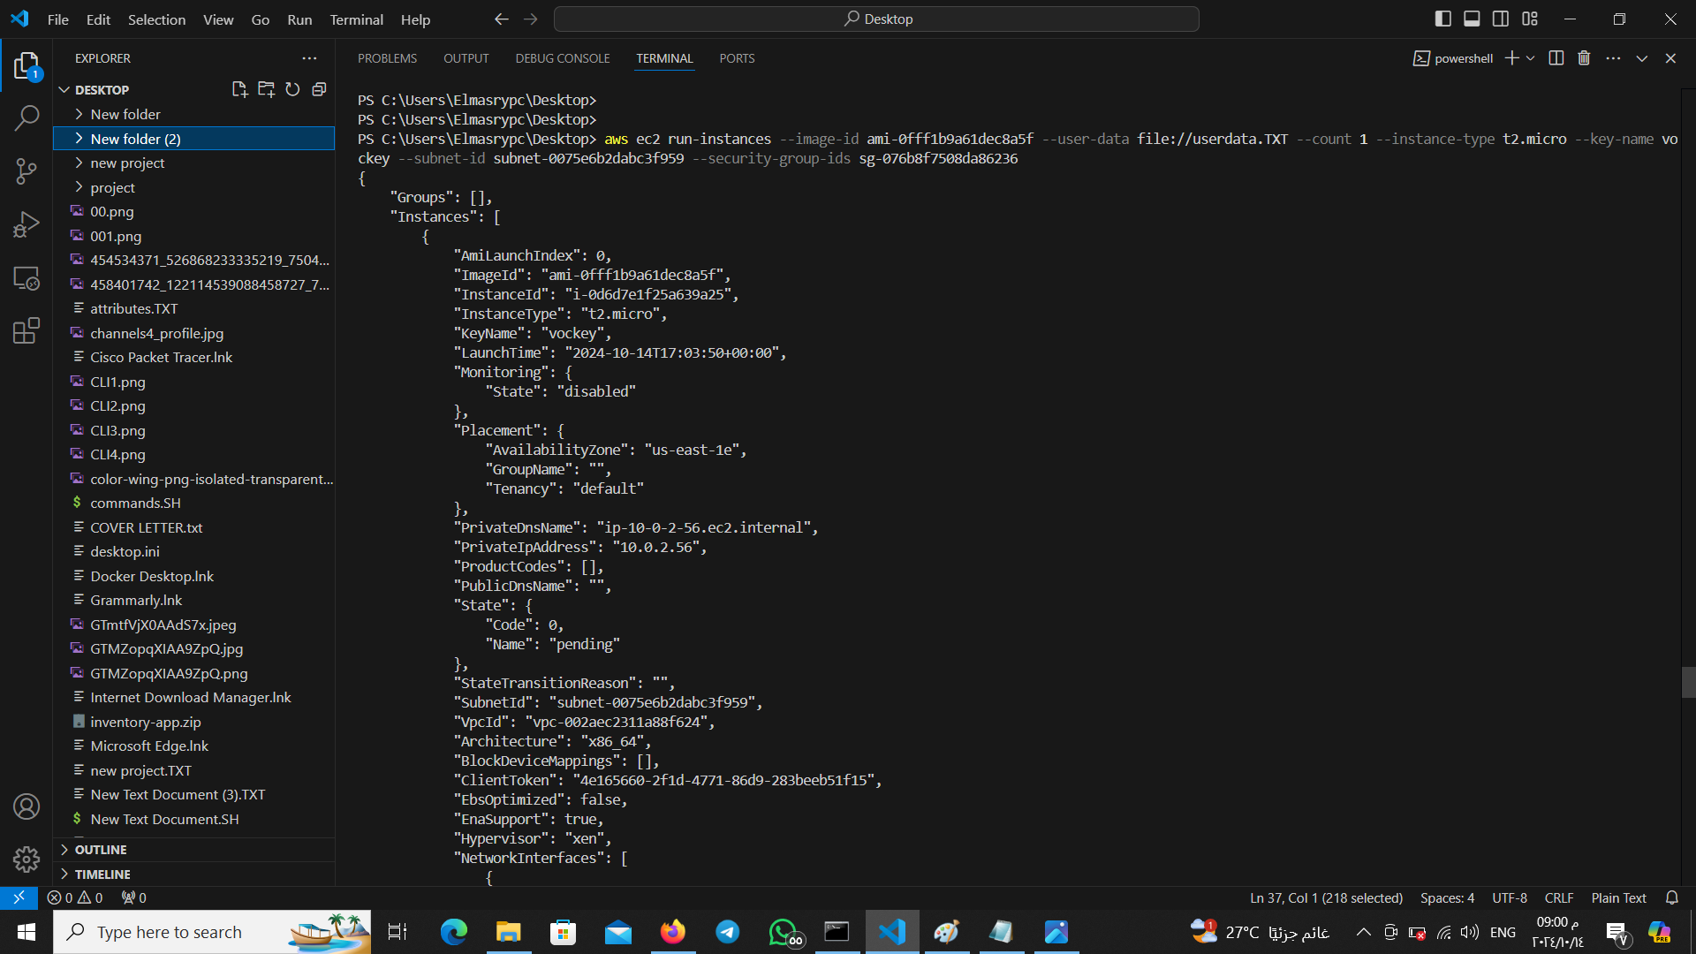
outputs

Slide 22
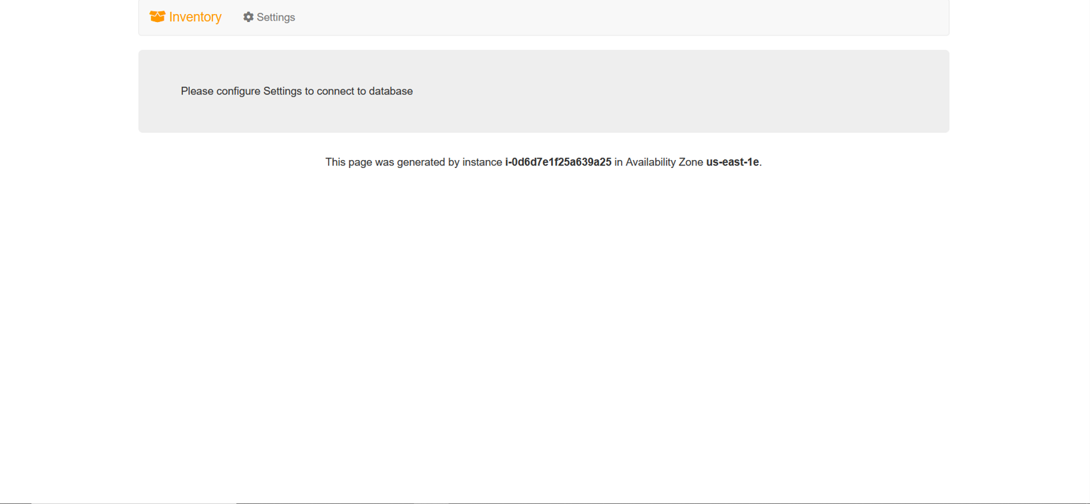
outputs

Slide 23
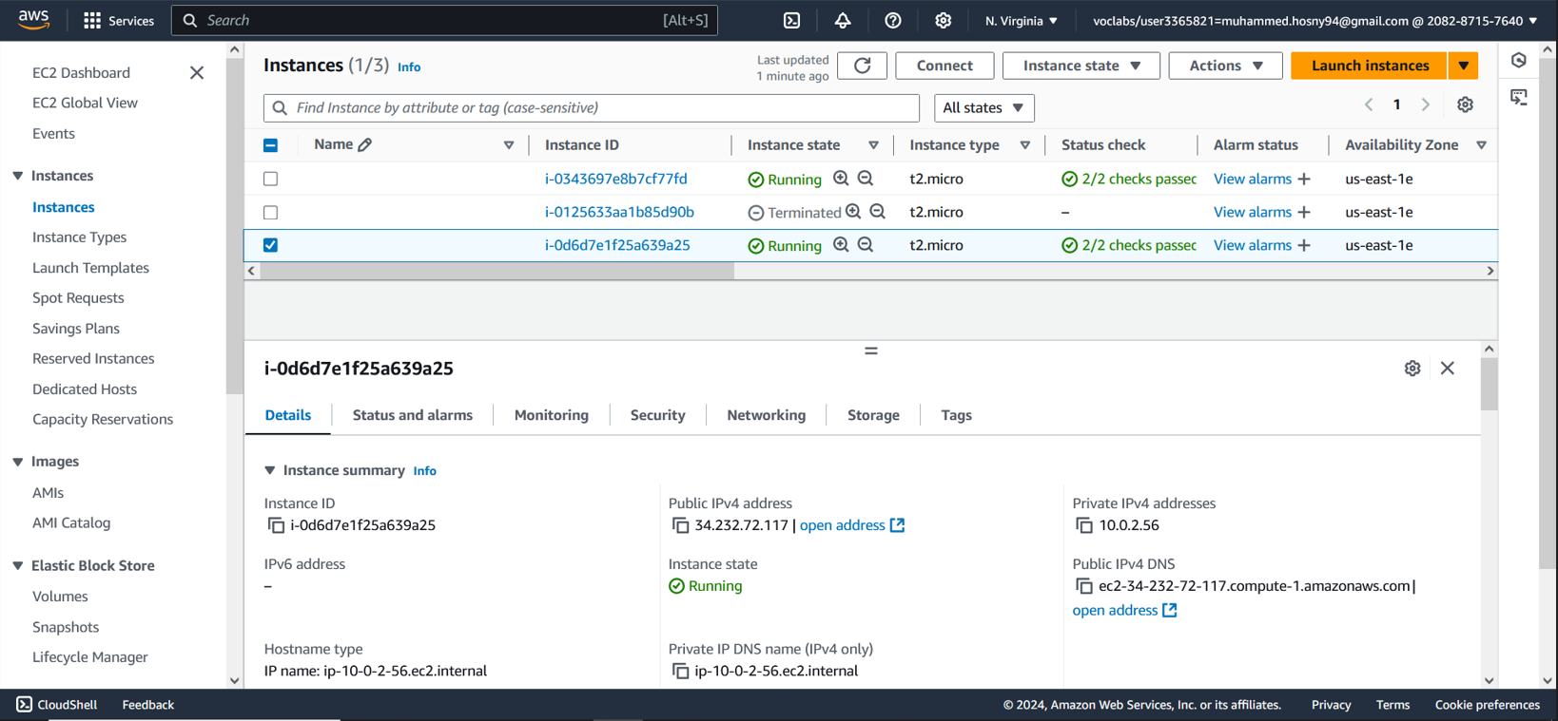
outputs

Slide 24
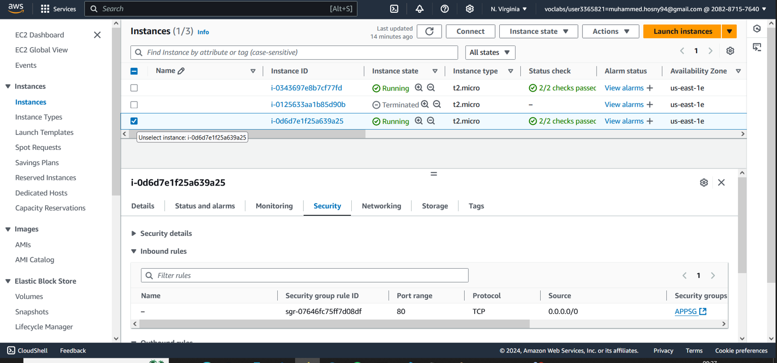
outputs

Slide 25
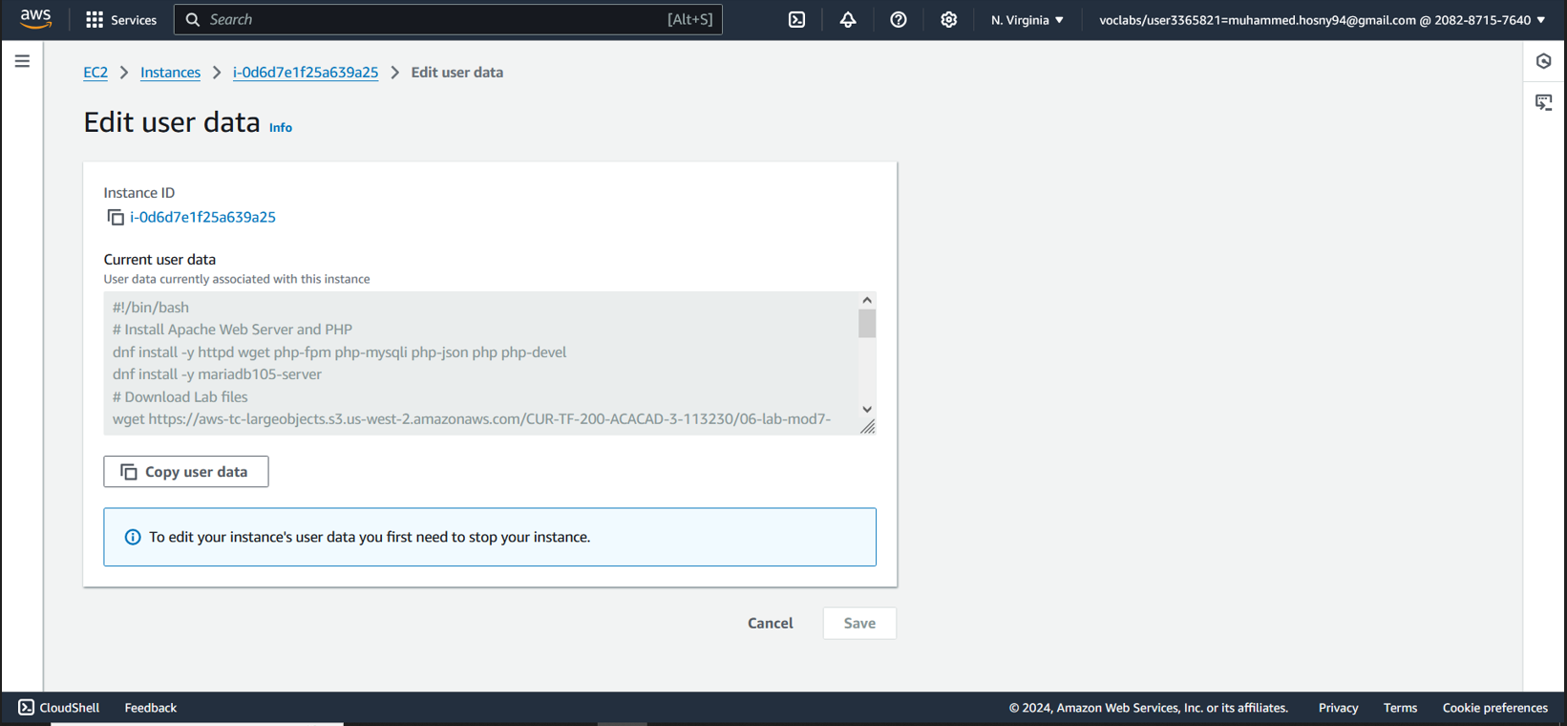
outputs

Slide 26
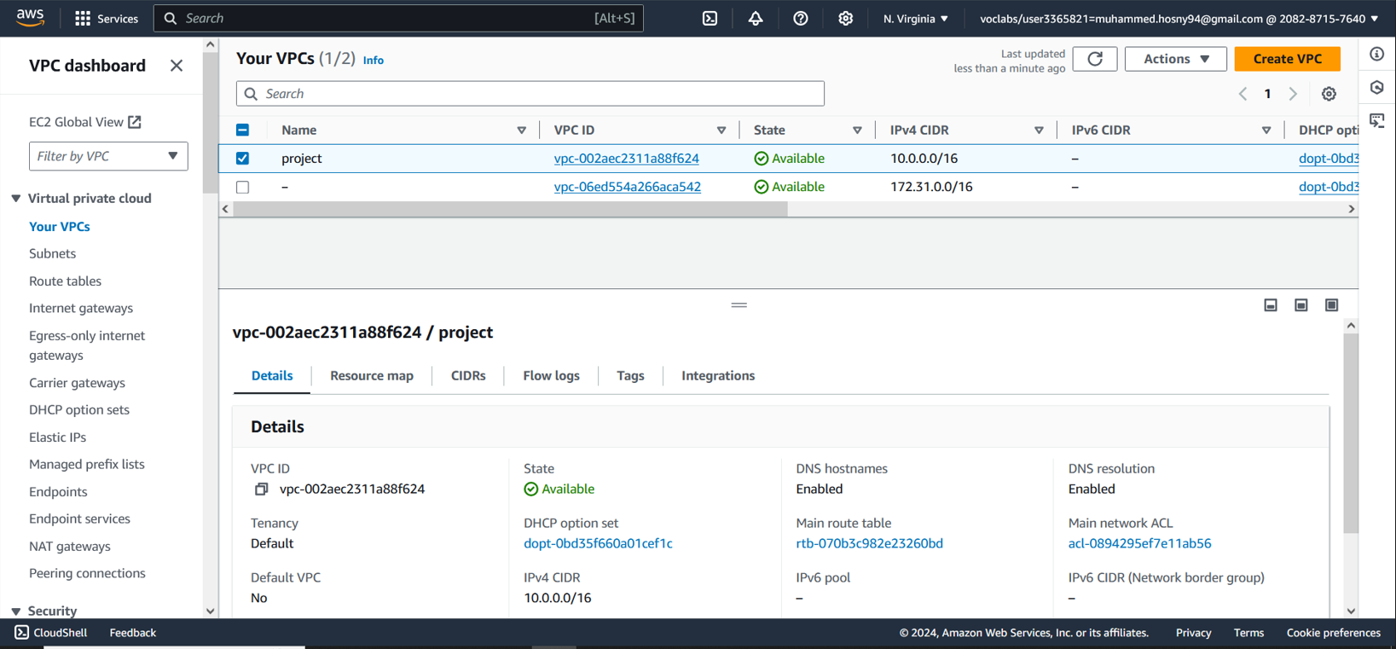
outputs

Slide 27
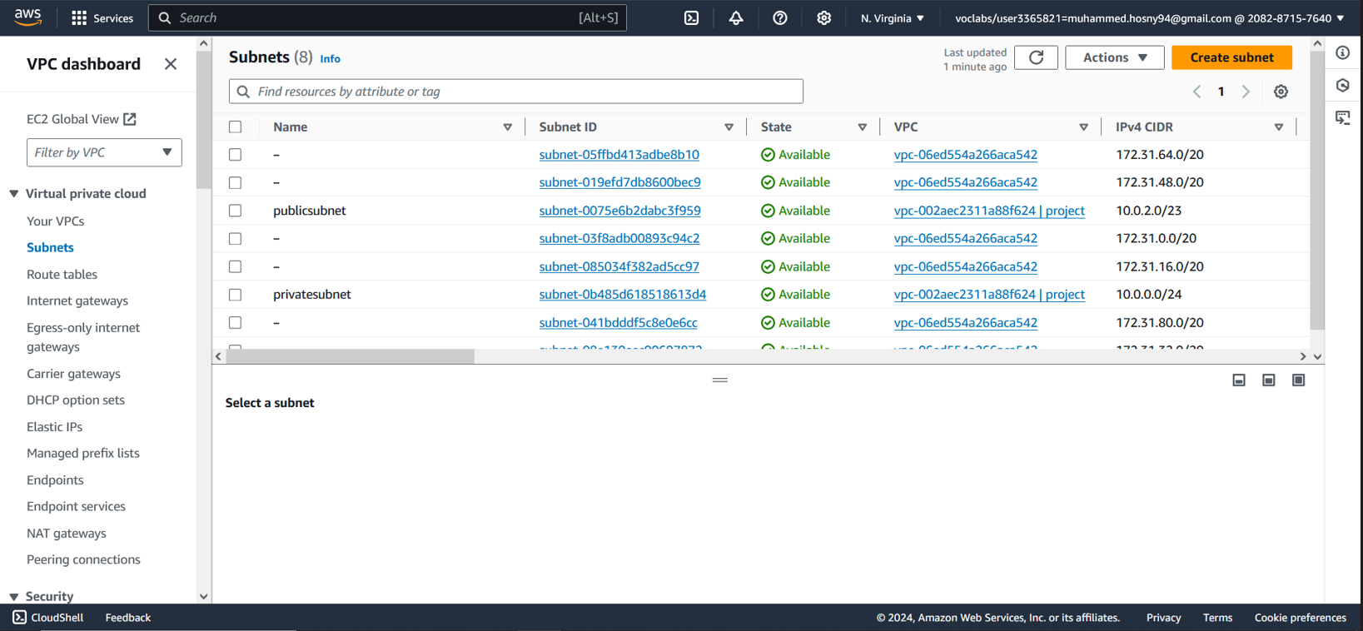
outputs

Slide 28
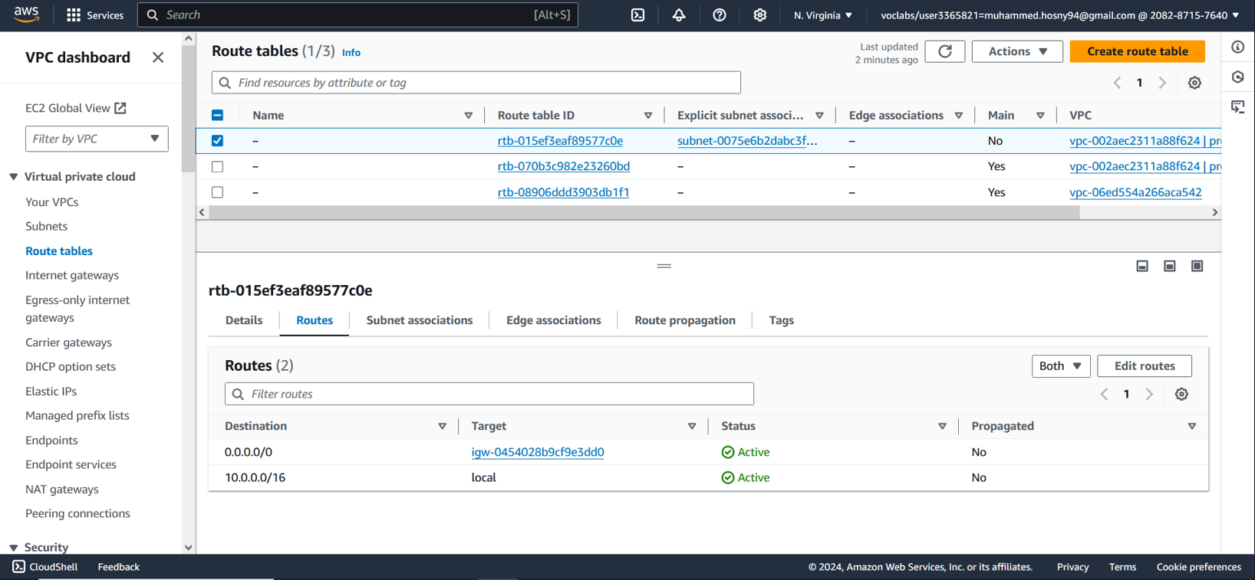
outputs

Slide 29
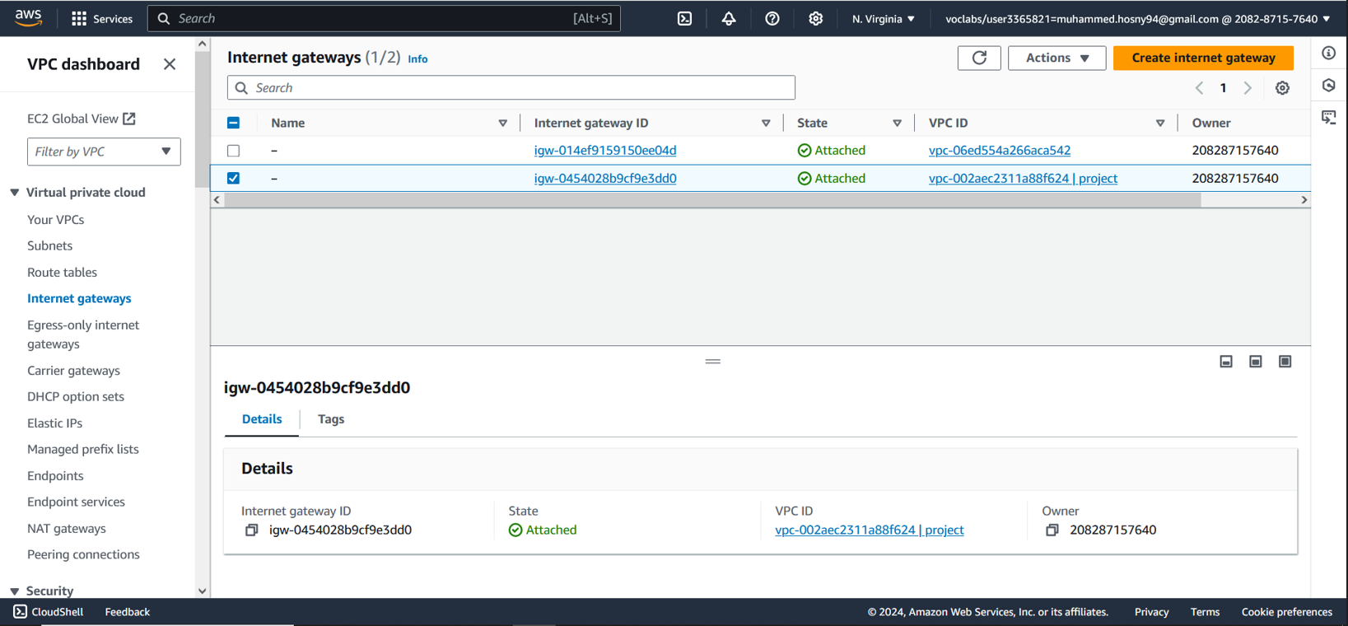
outputs

Slide 30
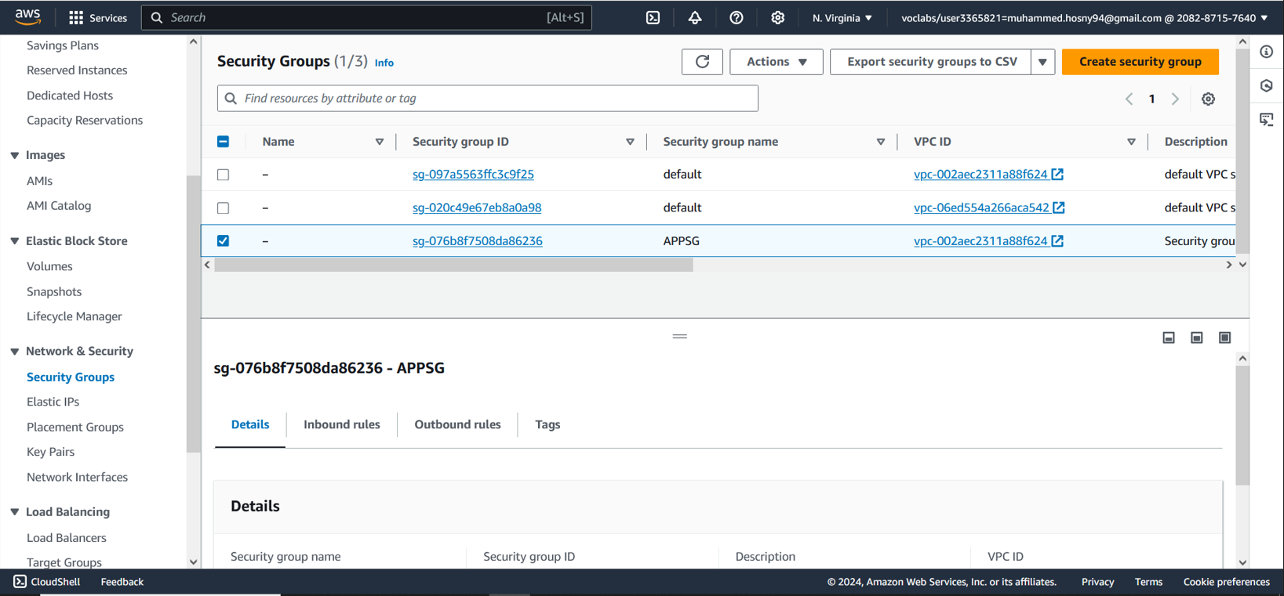
outputs

Slide 31
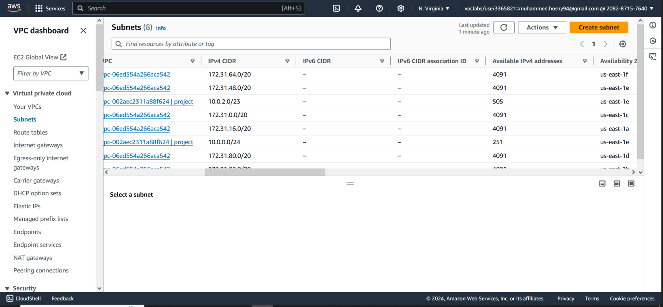
outputs

Slide 32
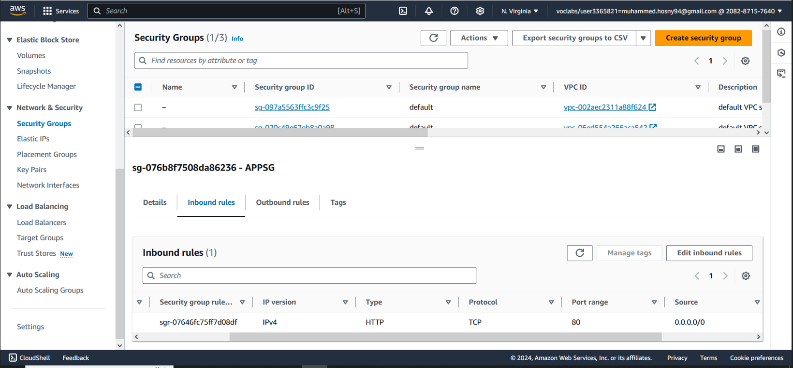
outputs

Slide 33
Thank You

Slide 34
Questions ??

